Slide 1
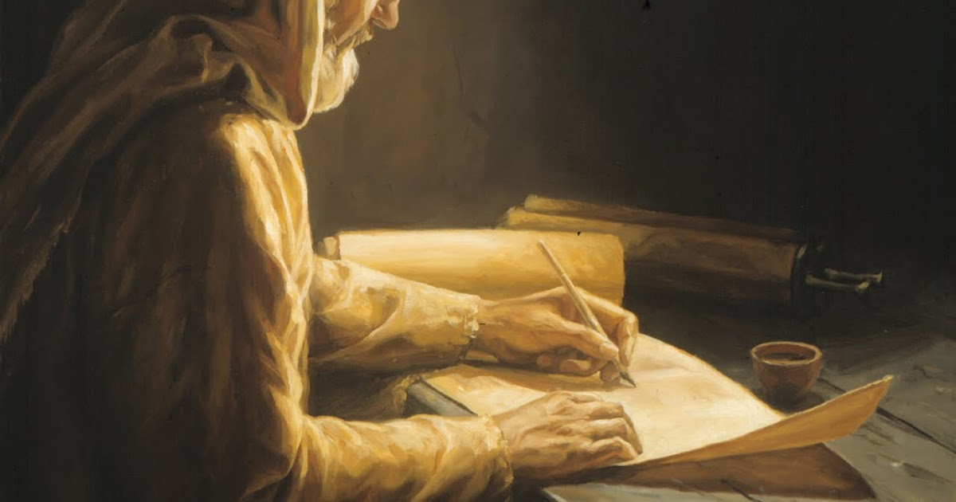
What Has the Lord Spoken?
Jeremiah 23:35
This Week’s Theme for the Warfield Blvd. church of Christ

Slide 2
What Has the Lord Spoken?
Jeremiah 23:35
“Preach unto it the preaching that I bid thee” – Jonah 3:2

Slide 3
God Has Always Had a Message of Salvation for Those Doomed in Sin
For Cain – Gen. 4:3-7
Noah’s day – Gen. 6; Heb. 11:7; 1 Pet. 3:20, 21
Thru Moses, “Let my people go…” - Exodus 5-10
At Sinai: the Law. Hear, do, and live (Deut. 30:16)
Eventually He sent His Son Jesus, His prophet, that men might hear his gospel, harken and blessed through forgiveness (Acts 3:22-26)

Slide 4
Acts 3:22-26
“Moses indeed said, A prophet shall the Lord God raise up unto you from among your brethren, like unto me. To him shall ye hearken in all things whatsoever he shall speak unto you. ²³ And it shall be, that every soul that shall not hearken to that prophet, shall be utterly destroyed from among the people…. ²⁶ Unto you first God, having raised up his Servant, sent him to bless you, in turning away every one of you from your iniquities.”
Paul said, (God) “manifested His word through preaching” – Titus 1:3

Slide 5
“What Has the Lord Spoken”
Men had to learn not to mock it – Jeremiah 23
Can’t run from it – Jonah 2
No amount of money will change it – Numbers 22-24; 2 Peter 2:15, 16
Preach it! – 2 Timothy 4:1-5
Do it, obey it! – James 1:21-27

Slide 6
Preaching that Pleases God is Done by Preachers Who…
Do not seek to endear the congregation to themselves, but endear the congregation to Jesus and the word of God…
Gal 1:10 For am I now seeking the favor of men, or of God? or am I striving to please men? if I were still pleasing men, I should not be a servant of Christ.

Slide 7
1 Thess. 1:2, “…we were bold in our God to speak to you the gospel of God in much conflict. ³ For our exhortation did not come from error or uncleanness, nor was it in deceit. ⁴ But as we have been approved by God to be entrusted with the gospel, even so we speak, not as pleasing men, but God who tests our hearts. ⁵ For neither at any time did we use flattering words, as you know, nor a cloak for covetousness—God is witness. ⁶ Nor did we seek glory from men, either from you or from others, when we might have made demands as apostles of Christ. … ⁸ So, affectionately longing for you, we were well pleased to impart to you not only the gospel of God, but also our own lives….” (NKJV)

Slide 8
Preaching that Pleases God is Done by Preachers Who…
Realize they have a charge – 2 Tim. 4:1-5
Need to be “on fire”, stirred up – 2 Tim. 1:6
Need to stir the brethren like Jesus (Lk. 23:5), Peter (2 Pet. 1:13; 3:1) and Paul (Acts 19:23)
Preaching the whole counsel of what the Lord has spoken will stir controversy! And save some!

Slide 9
1 Cor. 1:18 For the message of the cross is foolishness to those who are perishing, but to us who are being saved it is the power of God. ¹⁹ For it is written: "I WILL DESTROY THE WISDOM OF THE WISE, AND BRING TO NOTHING THE UNDERSTANDING OF THE PRUDENT." ²⁰ Where is the wise? Where is the scribe? Where is the disputer of this age? Has not God made foolish the wisdom of this world? ²¹ For since, in the wisdom of God, the world through wisdom did not know God, it pleased God through the foolishness of the message preached to save those who believe.

